Slide 1
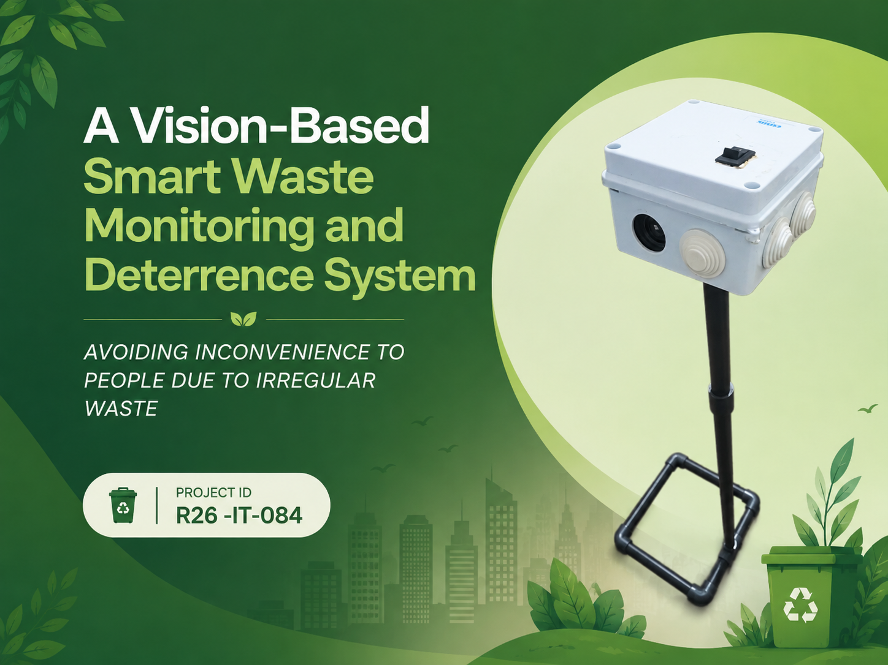

Slide 2









Our Team
IT22194312
Ranaweera K.U.I.C
IT22200006
Edirisinghe E.A.C.S
IT22262318
Ranasinghe M.J.N
IT22296214
Herath H.M.A.M

Slide 3

Problem & motivation
Current Waste Management Challenges
Impact
Overflowing and irregularly managed garbage bins
Improper waste disposal and littering
Animal interference around waste bins
Illegal/improper dumping in public areas
Limited real-time information for waste collection
Inefficient communication between the public and garbage collectors
Public Inconvenience
Hygiene & Environmental Risks
Inefficient Waste Collection
Increased Municipal Management Effort

Slide 4
Solution Overview
This research proposes a “Vision-based smart waste monitoring system” that uses IOT devices, computer vision, and machine learning to improve municipal waste management in urban areas.
The system installs a smart monitoring device above public garbage bins to monitor waste conditions in real time.
The device capture images and environmental data, process them using AI models, and sends the results to a cloud based monitoring system.

Slide 5
Functional Goals
Classify waste categories
Monitor bin capacity
Detect and deter animals
Detect and assess litter
Detect improper dumping and provide voice guidance
Assess waste-related hygiene risk
Predict future waste demand
Monitor, report and locate bins
Non-Functional Goals
Responsiveness | Reliability | Usability | Scalability
Near-real-time detection & response | Reliable component communication | Simple user interfaces | Multi-bin & multi-location support

Slide 6
Research Gap & Objectives
Feature | Existing / Typical Solutions | VisionWaste Solution
Waste Classification | Focuses mainly on identifying waste categories | AI-based organic/non-organic classification integrated with waste monitoring
Bin Fill-Level | Monitors bin capacity, often as a standalone function | Vision-based fill-level detection integrated with collection information
Animal Interference | Detection or monitoring without automated response | Animal detection with automated deterrence
Litter Monitoring | Limited identification of surrounding litter | Litter detection with severity assessment
Illegal Dumping | CCTV/surveillance with limited waste-specific response | Human activity detection with automated voice guidance
Waste & Hygiene Prediction | Reactive monitoring based on current conditions | Hygienic risk assessment + waste demand forecasting
Public & Collector Support | Limited interaction with smart-bin systems | Passenger + garbage collector mobile applications
System Integration | Separate/single-purpose solutions | Integrated AI + IoT + Cloud + Web + Mobile platform

Slide 7
Main Objectives
Classify waste using computer vision
Monitor bin fill level
Detect and deter animals
Detect litter severity
Detect improper human activity and provide voice guidance
Predict hygienic risk
Forecast future waste demand
Provide web-based monitoring
Support passengers and garbage collectors through mobile applications
DETECT
ANALYZE
PREDICT
RESPOND
SUPPORT

Slide 8
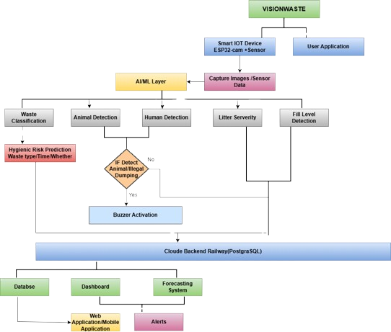
System Flow Diagram

Slide 9
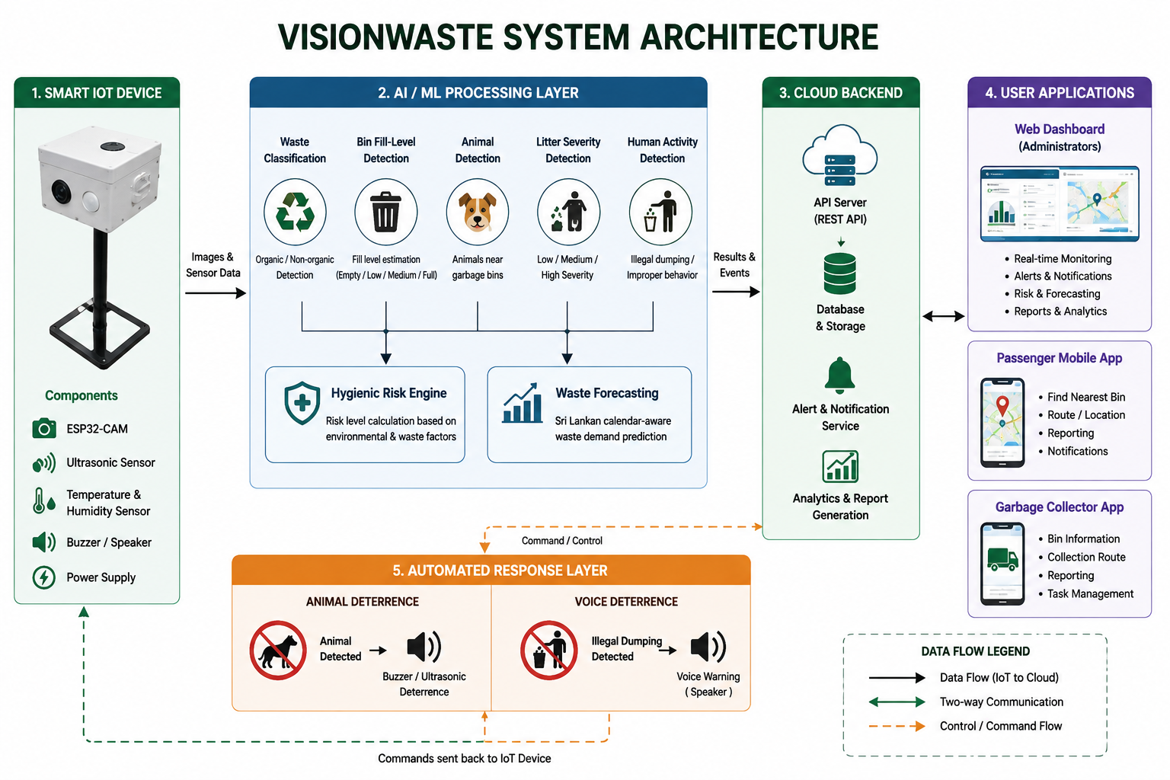
System Architecture Diagram

Slide 10

Completed Components & Research Contributions
Waste Classification + Hygienic Risk + Animal Detection & Deterrence - K.U.I.C. Ranaweera
Bin Fill-Level Detection + Passenger & Garbage Collector Mobile Application - E.A.C.S. Edirisinghe
Litter Severity Detection + Human Detection & Voice Deterrence - M.J.N. Ranasinghe
Sri Lankan Calendar-Aware Waste Forecasting - H.M.A.M. Herath

Slide 11
Commercialization
Target Users – Municipal Councils, Public Sector Organizations , Universities ,Tourism Locations
Value Proposition – Detect waste problems early, support efficient collection, reduce public inconvenience, and enable automated responses.
Deployment Roadmap – Prototype Pilot Deployment Municipal Deployment Multi-location Deployment Commercial Smart-waste Platform
Business Opportunity – Smart monitoring + AI analytics + automated deterrence + citizen/collector support

Slide 12
Conclusion
VisionWaste transforms conventional waste-bin monitoring into an integrated system that can detect, predict, respond, and support smarter waste management.

Slide 13
T h a n k Y o u

